Slide 1
Officer involved Fatal shootings
Michael Borenstein, Samuel Dailey,
Greg gilbert, Dion Davis, Steven Holder

Slide 2
Original Message
Determine correlation between officer involved shooting, time of day, location by income, population density, economic factors (i.e. unemployment), and weather.
Charlotte Police department

Slide 3
Questions
Does population play a role in an officer involved shooting?
Is there any correlation between the population demographics and the police officer demographics in each division for each officer involved shooting?
Does the weather and time of day play a role in an officer involved shooting?

Slide 4
Data and Cleanup
Data Sets used
Census.gov
Remove Rows
Remove Puerto Rico and DC
Washington Post OIS data
Remove Columns and blanks
Combine Weapons
Demographic data.org
Remove %

Slide 5
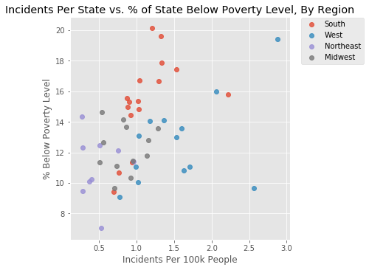
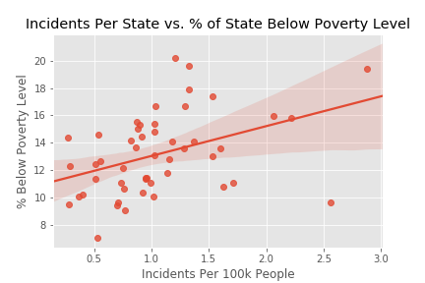
Analysis-Poverty
Ranking | State | Incidents/100k | % Below Poverty
1 | NM | 2.883 | 19.44%
2 | AK | 2.561 | 9.65%
3 | OK | 2.217 | 15.81%
4 | AZ | 2.063 | 15.98%
5 | WY | 1.708 | 11.04%
Ranking | State | % Below Poverty | Incidents/100k
1 | MS | 20.17% | 1.205
2 | LA | 19.61% | 1.324
3 | NM | 19.44% | 2.883
4 | KY | 17.90% | 1.330
5 | WV | 17.42% | 1.529
Higher number of incidents per state in states with more poverty
Higher number of incidents in western region, poverty more prevalent in south and west

Slide 6
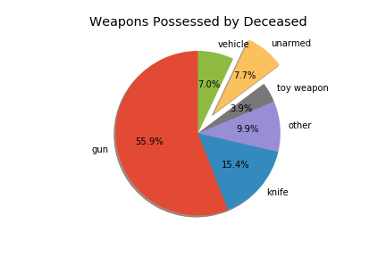
Analysis-Weapons
Over 92% of civilians killed in police incidents were armed with some type of weapon, 56% had guns.
3.9% were carrying toy weapons, and 7.7% of fatalities were completely unarmed.

Slide 7
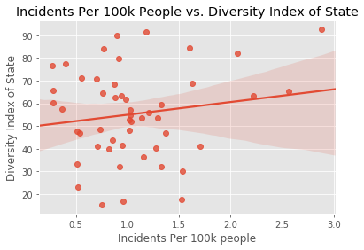
Analysis-Diversity of State
Positive trend shows higher number of incidents in more diverse states
Diversity index formula (first developed by USA Today) calculates chance that two people chosen randomly from an area will be different by race and ethnicity
Ranking | State | Incidents/100k | % Diverse
1 | NM | 2.883 | 92.4%
2 | AK | 2.561 | 65.4%
3 | OK | 2.217 | 63.4%
4 | AZ | 2.063 | 82.2%
5 | WY | 1.708 | 41.1%
Ranking | State | % Diverse | Incidents/100k
1 | NM | 92.4% | 2.883
2 | CA | 91.4% | 1.180
3 | TX | 89.7% | 0.897
4 | NV | 84.5% | 1.599
5 | HI | 84.2% | 0.770

Slide 8
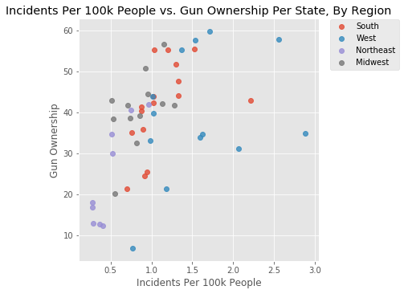
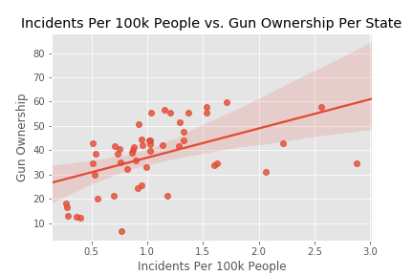
Analysis-Gun Ownership
Increase incidence in states with higher gun ownership
The west region has a number o states with high ownership and incidents than other regions.
Ranking | State | Incidents/100k | Gun Owner %
1 | NM | 2.883 | 34.8
2 | AK | 2.561 | 57.8
3 | OK | 2.217 | 42.9
4 | AZ | 2.063 | 31.1
5 | WY | 1.708 | 59.7
Ranking | State | Gun Owner % | Incidents/100k
1 | WY | 59.7 | 1.708
2 | AK | 57.8 | 2.561
3 | MT | 57.7 | 1.535
4 | SD | 56.6 | 1.155
5 | WV | 55.4 | 1.529

Slide 9
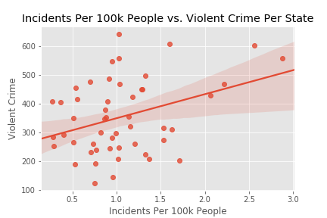
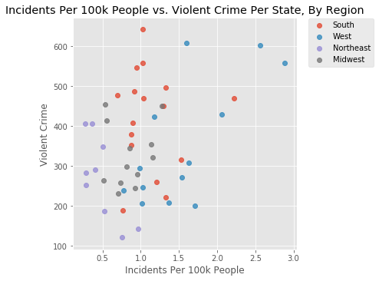
Analysis-Violent Crimes
Ranking | State | Incidents/100k | Violent Crime/100k
1 | NM | 2.883 | 559.1
2 | AK | 2.561 | 603.2
3 | OK | 2.217 | 469.3
4 | AZ | 2.063 | 428.9
5 | WY | 1.708 | 201.4
States with higher violent crime rates show a increase in police shooting deaths
Red region higher number of violent crimes but Blue has increased in incidents
Ranking | State | Violent Crime/100k | Incidents/100k
1 | TN | 643.6 | 1.022
2 | NV | 607.6 | 1.599
3 | AK | 603.2 | 2.561
4 | NM | 559.1 | 2.883
5 | SC | 558.8 | 1.028

Slide 10
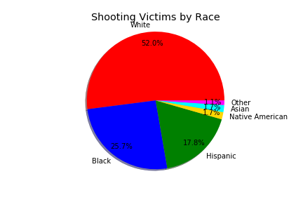
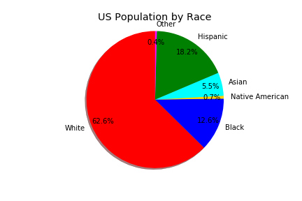
Analysis-Race of Deceased
When Race of Deceased is compared to US Population by Race, the ratio is nearly 1:1 for Hispanics and Whites
The percentage of shooting victims is 2:1 when compared to the percentage of US population for Asians and Blacks and even higher for Native Americans

Slide 11
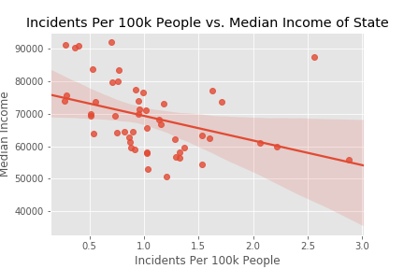
Analysis-income
Higher rates of incidents in states with lower median state income
Majority of incidents occurred in states with median income between $55,000 and $80,000
Ranking | State | Incidents/100k | Median Income
1 | NM | 2.883 | 55900
2 | AK | 2.561 | 87365
3 | OK | 2.217 | 59742
4 | AZ | 2.063 | 61001
5 | WY | 1.708 | 73654
Ranking | State | Median Income | Incidents/100k
1 | MS | 50592 | 1.205
2 | AR | 53123 | 1.037
3 | WV | 54409 | 1.529
4 | NM | 55900 | 2.883
5 | KY | 56522 | 1.330

Slide 12
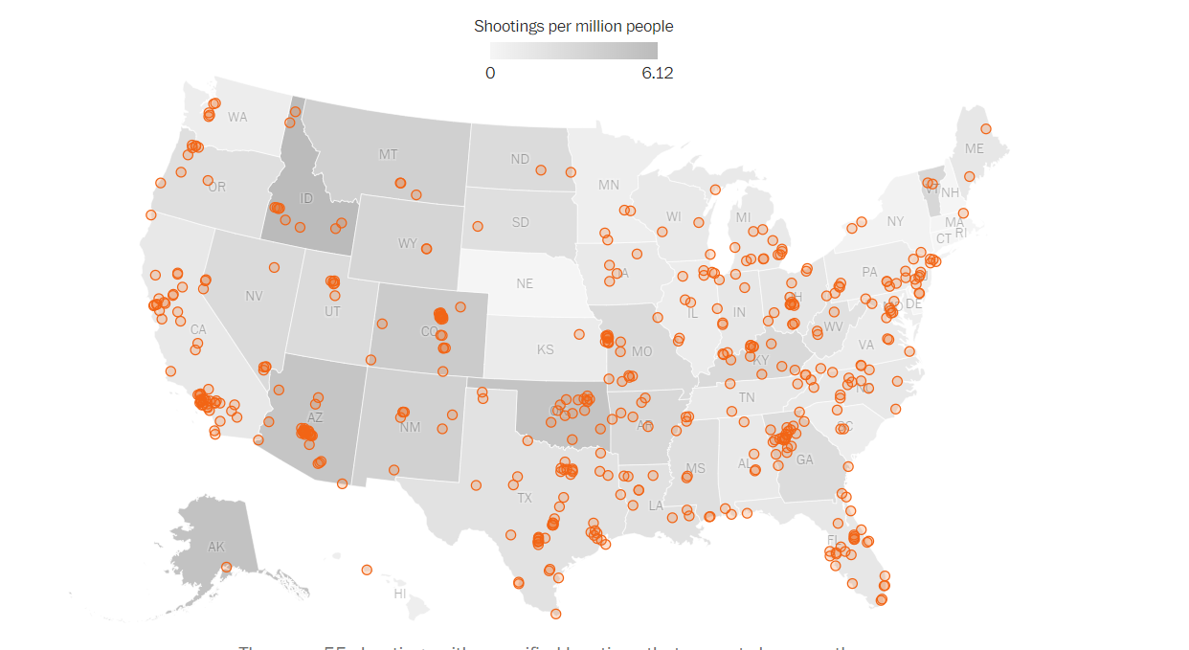
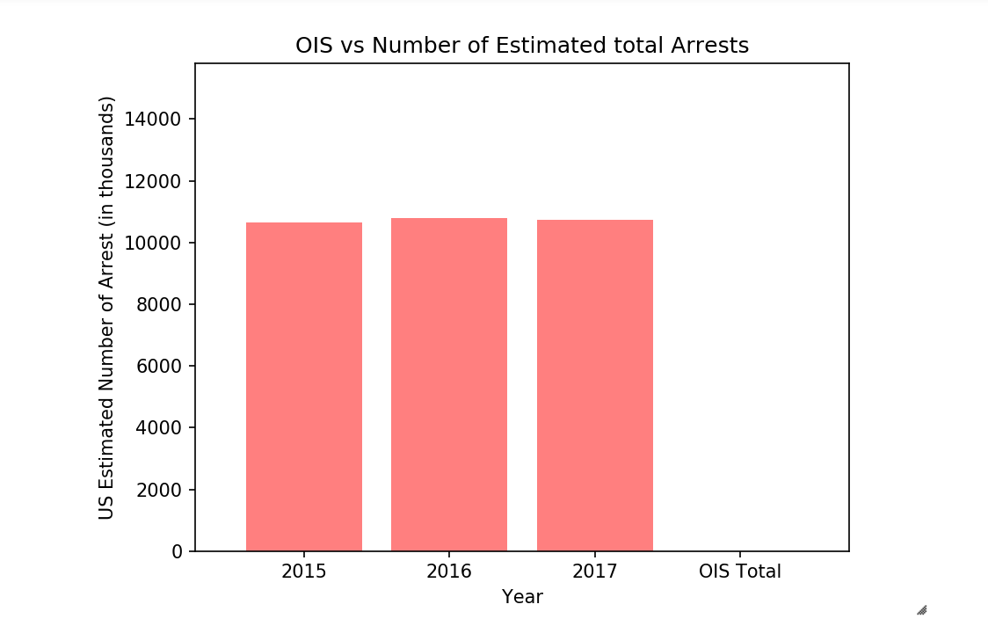
Analysis-Location & Frequency
The estimated number of total arrests 10.67M, 10.79M, 10.72M
OIS as a percentage of estimated total arrests is less than .001%

Slide 13

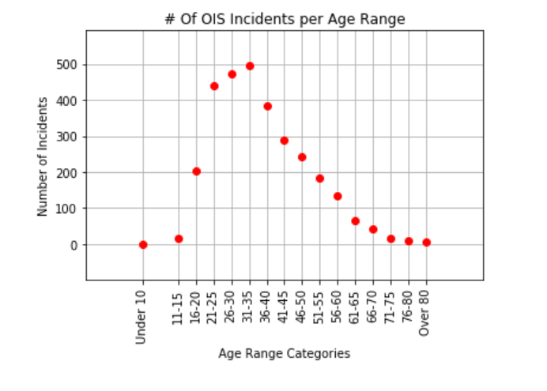
Analysis-age
494 Incidents Ages 31-35
474, 441 Age ranges 26-30 and 21-25 respectively
1 five year old, 1 twelve year old

Slide 14

Data affects perspective
0ver 50% of shootings were white male
There is less than .001% chance of being killed during law enforcement encounter
Incidents congruent with national population with the exception of blacks which make up 12.6% of US pop and 25% of OIS incidents population

Slide 15
Conclusions/implications
Based on the data that was collected, our analysis shows that officer involved shootings (OIS) occur more in states that are located in the western united states. Those states have a higher percentage of gun ownership. In more than half of the incidents of OIS, the suspect possessed a gun as a weapon. The poverty level correlates to the amount of violence that occurs, mostly in states located in the western and southern united states.
The correlation of population and race of deceased is proportionate with the exception of blacks which shows almost twice the percentage of blacks being killed in an oIS.

Slide 16
Difficulties/Next steps
Difficulties
Number of data points with City of Charlotte
Location of shootings for OIS data
Finding a widely accepted numerical value for diversity of population
Next Steps
More detail info on crime data, gang related activity
We looked into factoring in mental illness but could not find any consistent data.
Get better location data to be able to drill down to possibly a zip code level to really look at correlation
Due to impact of high crime rates, poverty and low income levels try and look deeper into programs like (Head start) to measure their ability to reduce officer involved shootings

Slide 17
Story?
A person between the ages of 21-46 is more likely to resist arrest then any other age groups in Officer Involved Shooting.
Victims involved in officer involved shootings are found to be carrying a gun.
Higher incidents with populations with a lower poverty level.

